Slide 1
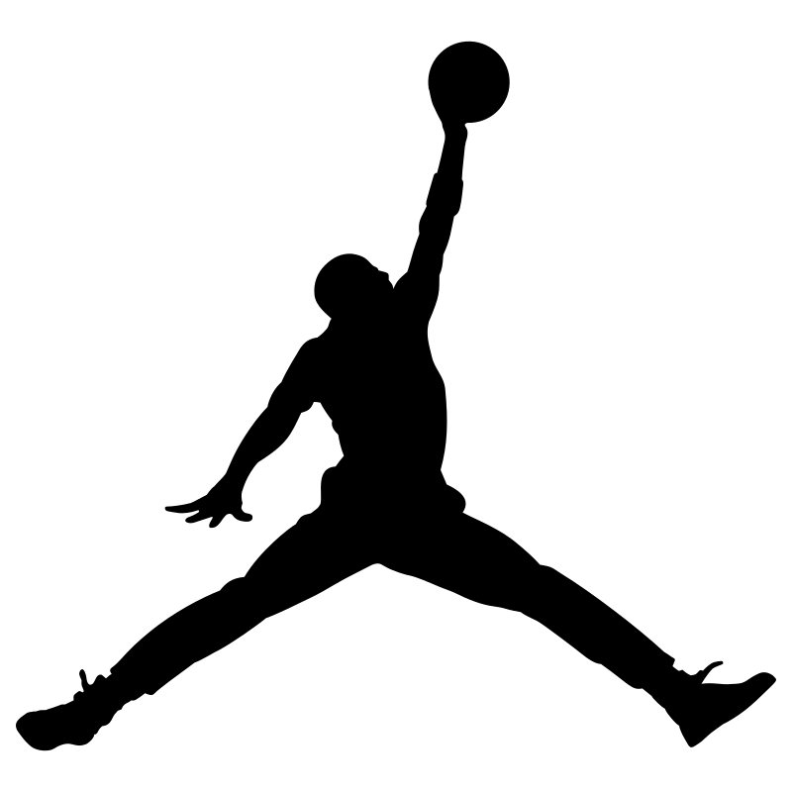
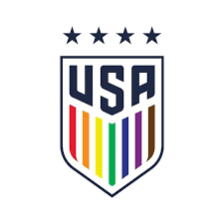
Strategic Partnership: Jordan Brand & USWNT
By Logan Wright
Notes:
Being the Official Apparel Sponsor

Slide 2
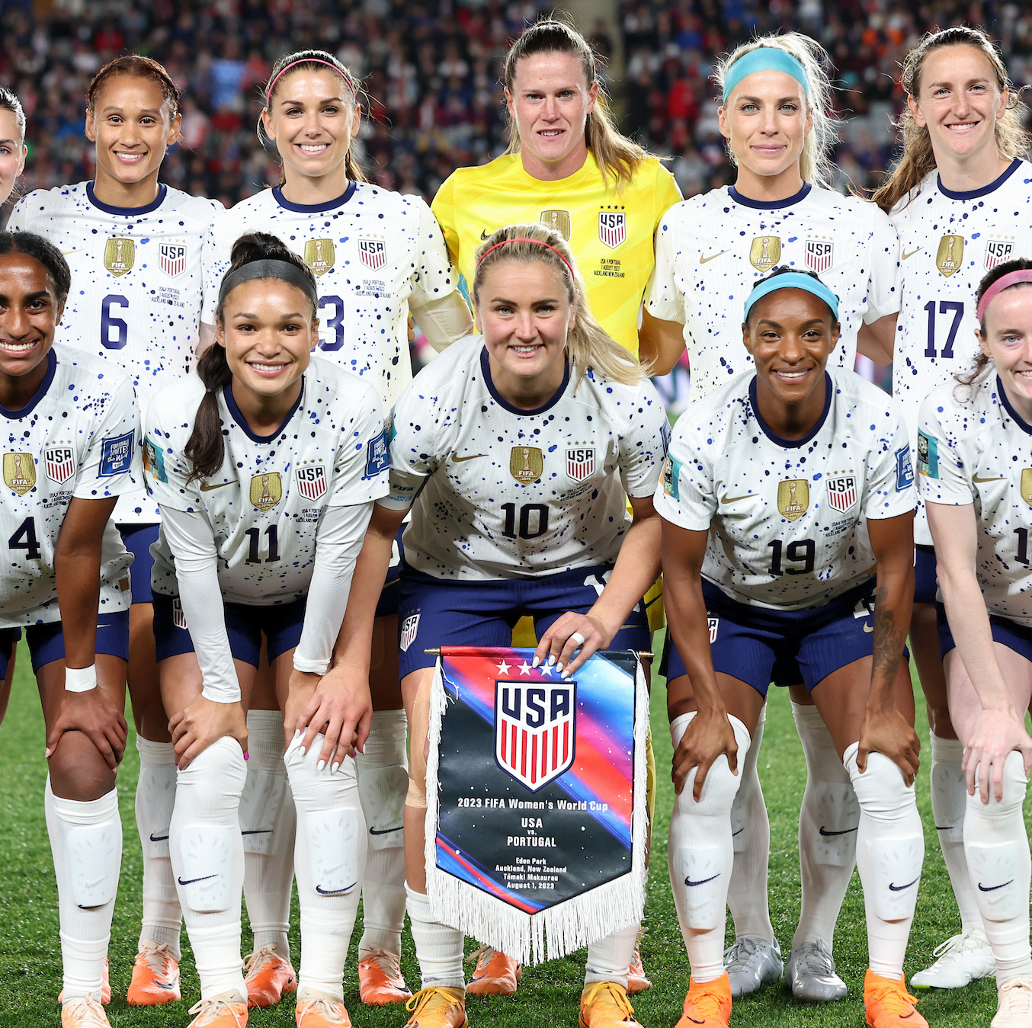
Introduction:
USWNT achievements: 4 World Cup titles, 9 Gold Cups, 6 She-Believe Cup
Growth of women's soccer globally
2019 viewership: 54% male, 46% female
2019 Women's World Cup viewership: 1.12 billion
Partnership potential: Shared values of excellence and social activism
Notes:
World cup started in 1991.

Slide 3
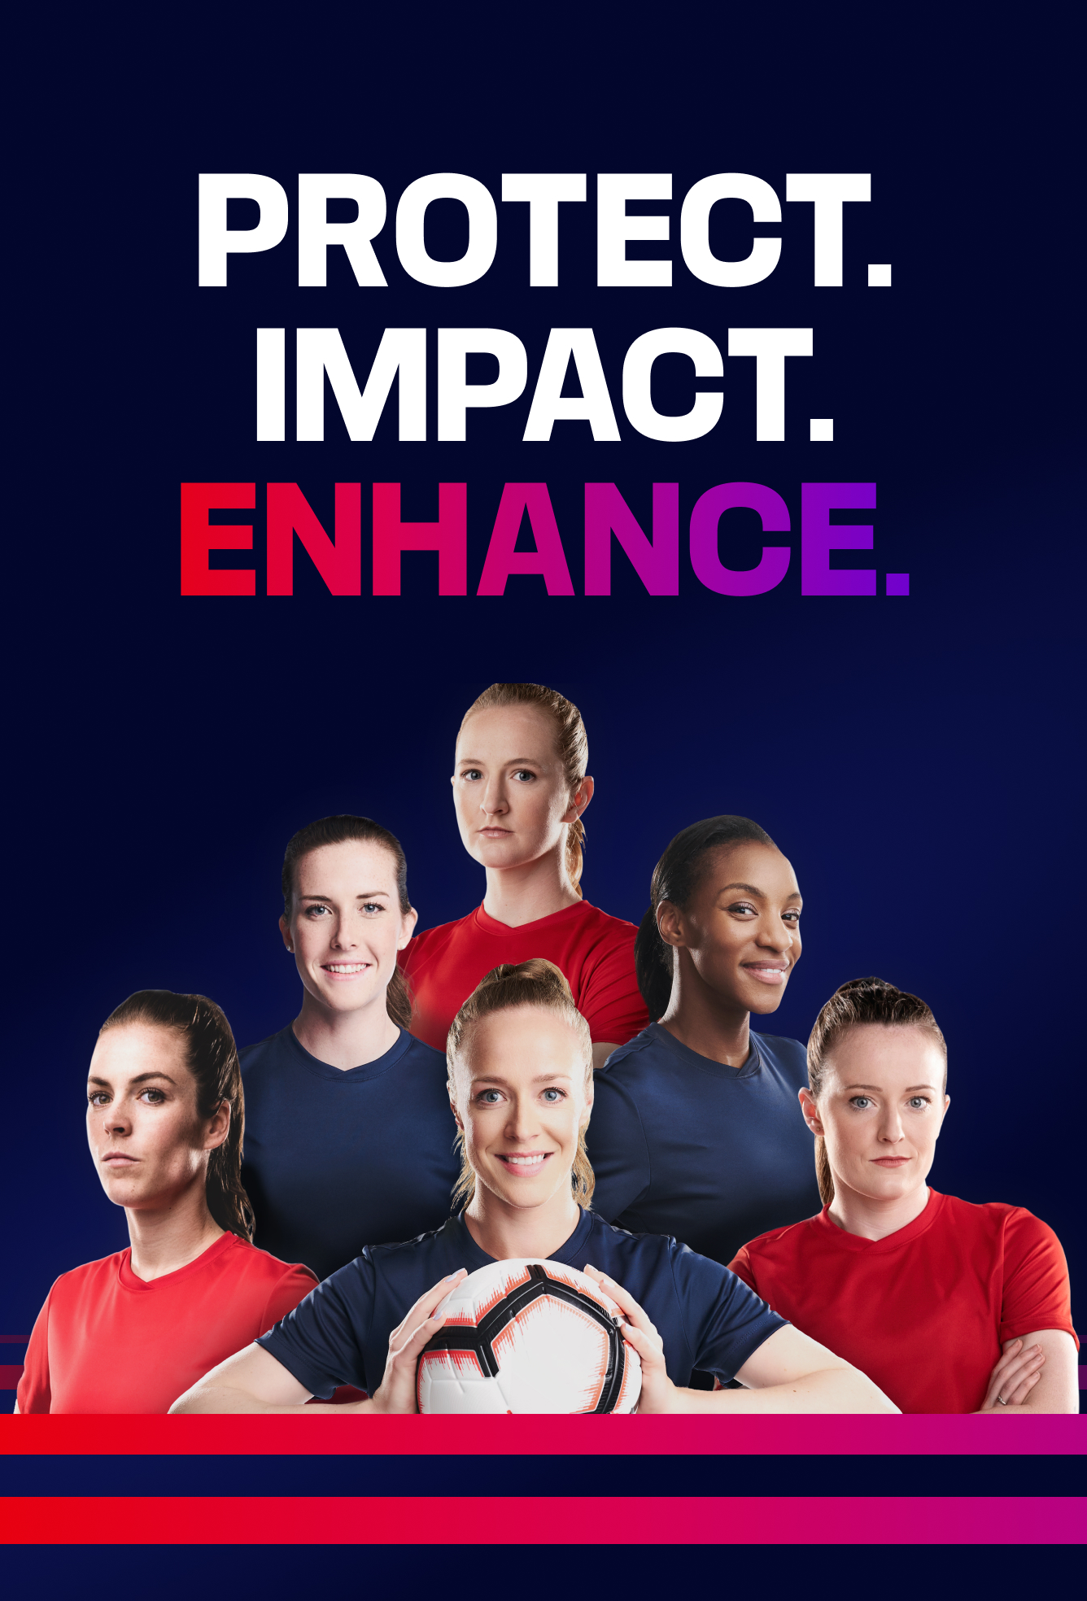
Positioning Jordan Brand with USWNT
Aligning themes: excellence, leadership, and competitive spirit
Associated with the Nike brand
Joint campaigns: "Excellence Defined” and ”Unstoppable Together”
Appeals to multiple generations
Highlighting USWNT's activism aligns with Jordan Brand’s leadership in social justice
Notes:
“Excellence Defined,” contains references to memorable events in both organizations' histories, appealing to sports fans who appreciate the work of dedicated athletes with different custom-made products.
- Events that connection the consumer to the products
-Pop-up stores with the athletes
–Small sided games with athletes to engage together to give content for the other campaign both connect the fans to the soccer/products
- Custom-designed jerseys and apparel
-Appeals to older and younger generations
“Unstoppable Together,” as this enlightens the experiences of the players of the USWNT hence making socially conscious consumers feel a deeper and emotional connection with the brand.
-Social media campaign that will bring a more personable and marketable for the consumer
-Other foundations and working with the already sponsored athletes
At the the heart of the 10-year, $100 million Black Community Commitment, announced by Michael Jordan and Jordan Brand in 2020, is a desire to take action where it is needed most. donate to charities and causes in their hometowns and communities.

Slide 4
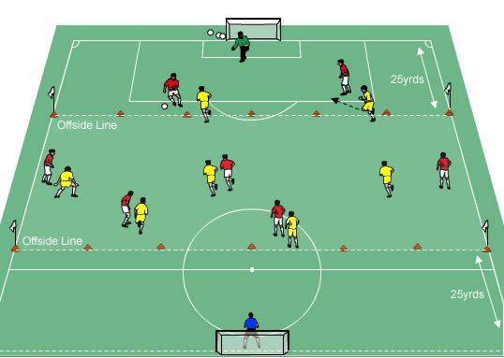
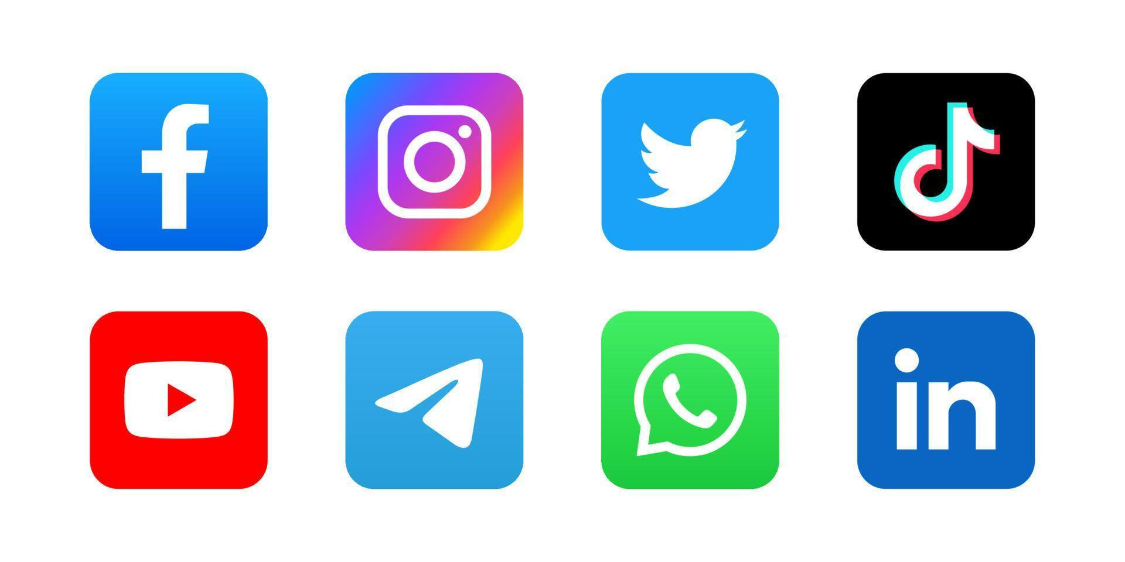
Capturing the Spirit
"Excellence Defined" campaign references historic achievements
Custom-designed jerseys and apparel
Appeals to older and younger generations
"Unstoppable Together" to humanize players and connect with socially conscious consumers
Small-sided games played with the team and signed athletes
Use of influencers
Capitalize on consumer trends
Notes:
campaign references historic achievements

Slide 5
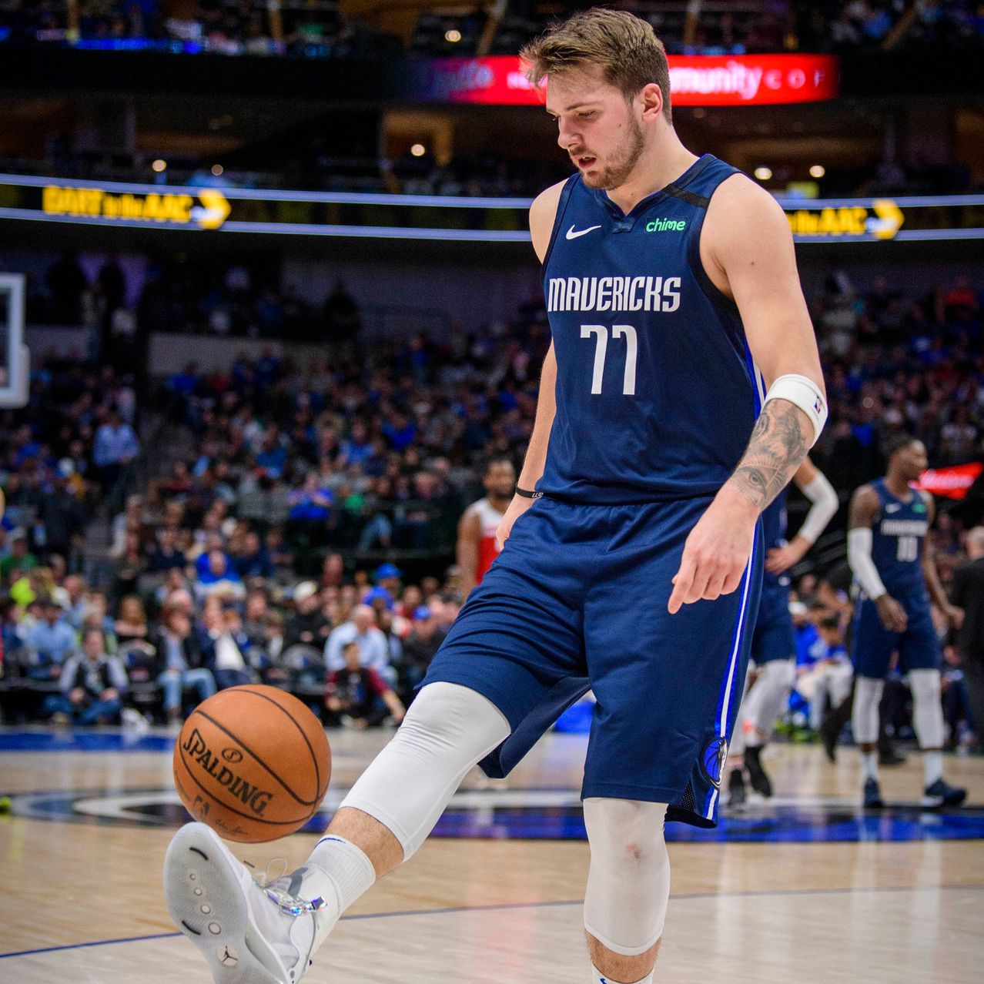
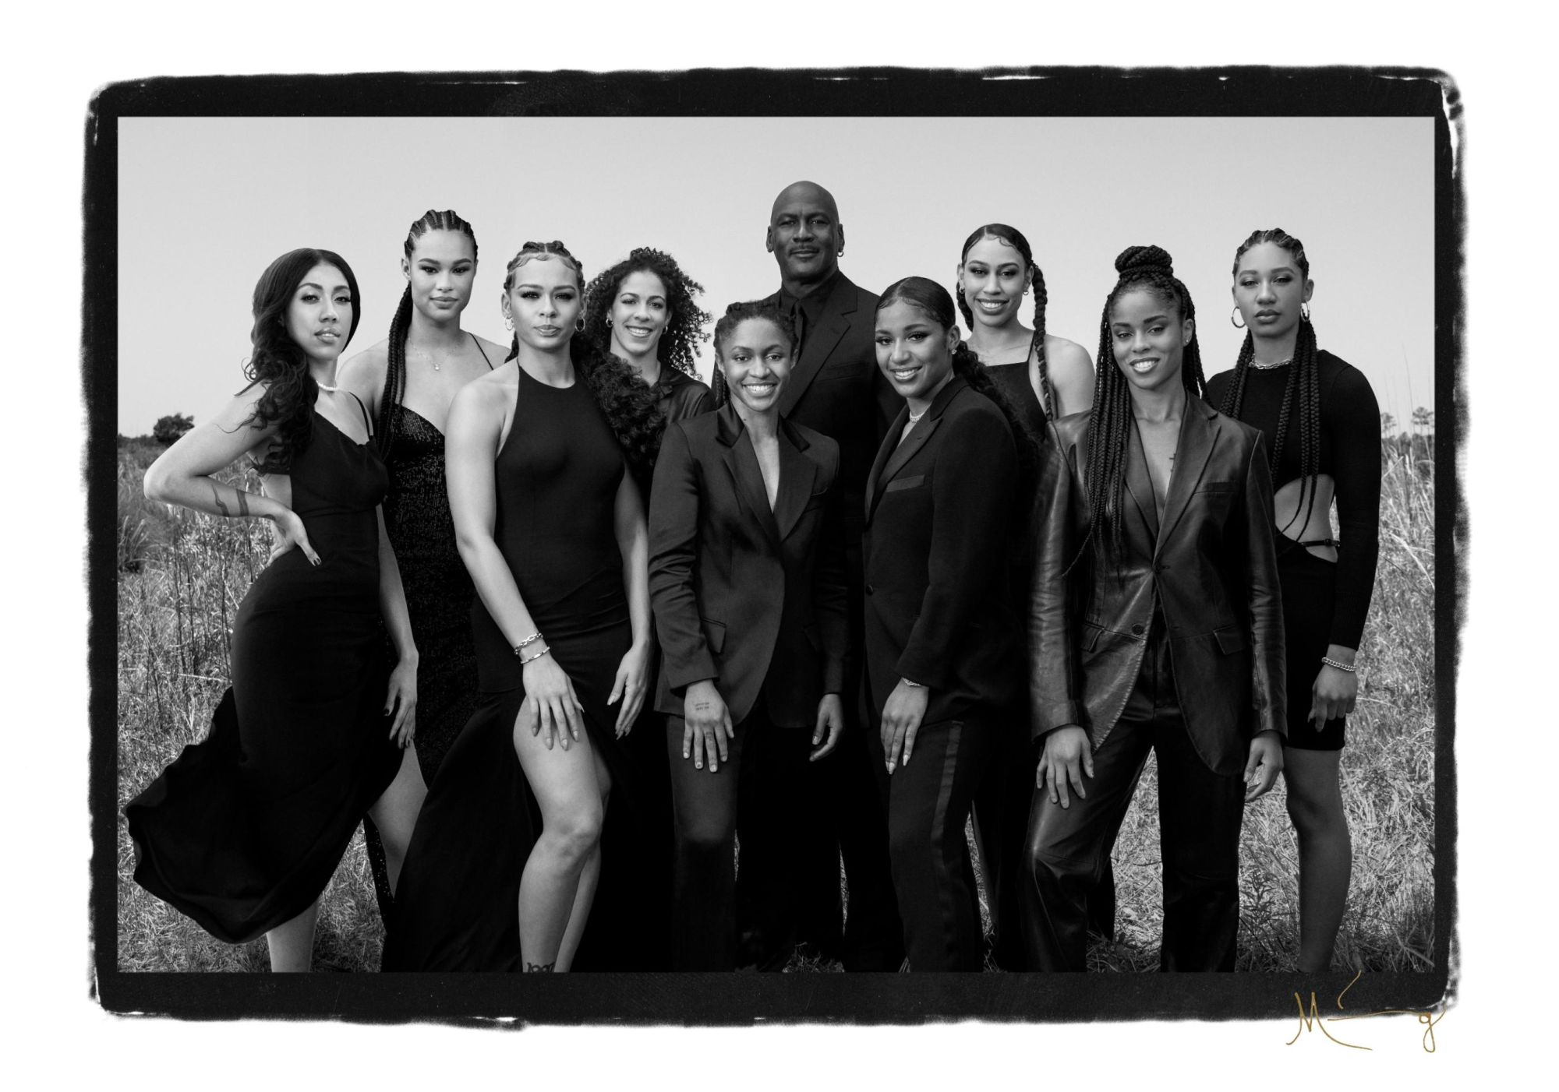
Leveraging Existing Partnerships
Involving existing Jordan Brand athletes: Luka Dončić, Billie Eilish, and WNBA athletes
Cross-promotion with WNBA and USWNT
Highlighting partnership through social media and media platforms
Notes:
NWSL

Slide 6
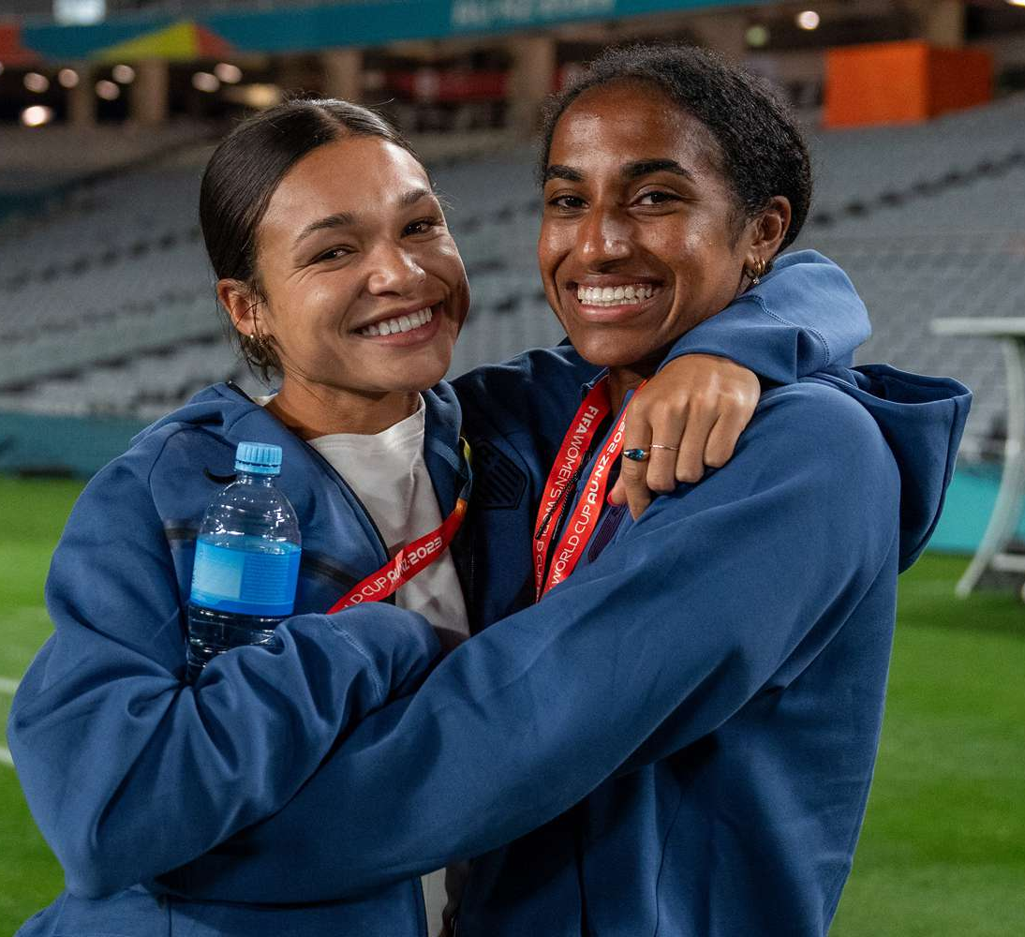

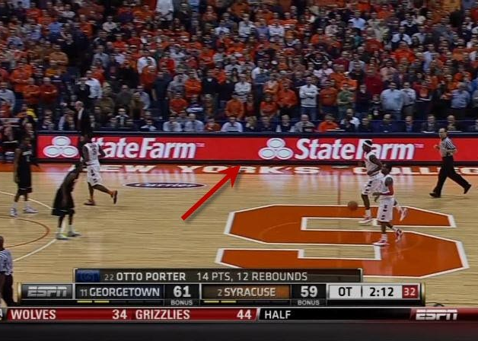
Targeting Future Collaborations
Collaborations with promising players: Sophia Smith, Naomi Girma
Partnerships with NWSL and Women's Sports Foundation finding synergy
Enhancing impact through advertisement specifically through WNBA and Football media coverage from ESPN and streaming services

Slide 7
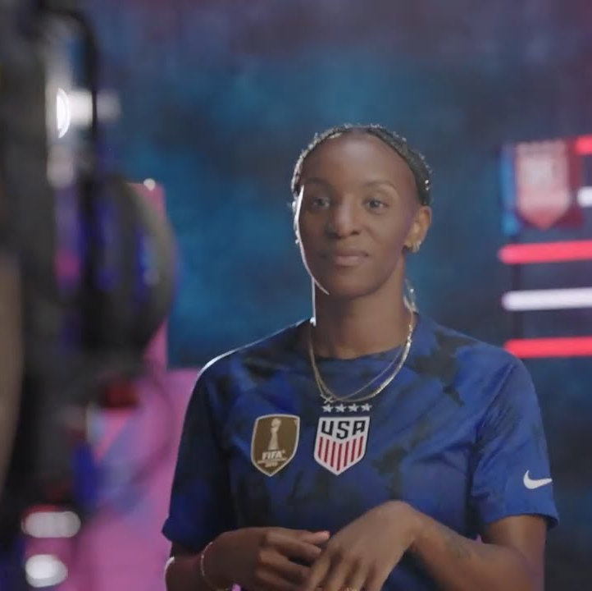
Engaging Consumers
Interactive events: Small-sided games, pop-up locations
Exclusive USWNT apparel and footwear (Excellence Defined)
Social media campaigns on Instagram and TikTok (Unstoppable Together)
Fan challenges and behind-the-scenes videos
Exciting fans for national team events and the partnership

Slide 8
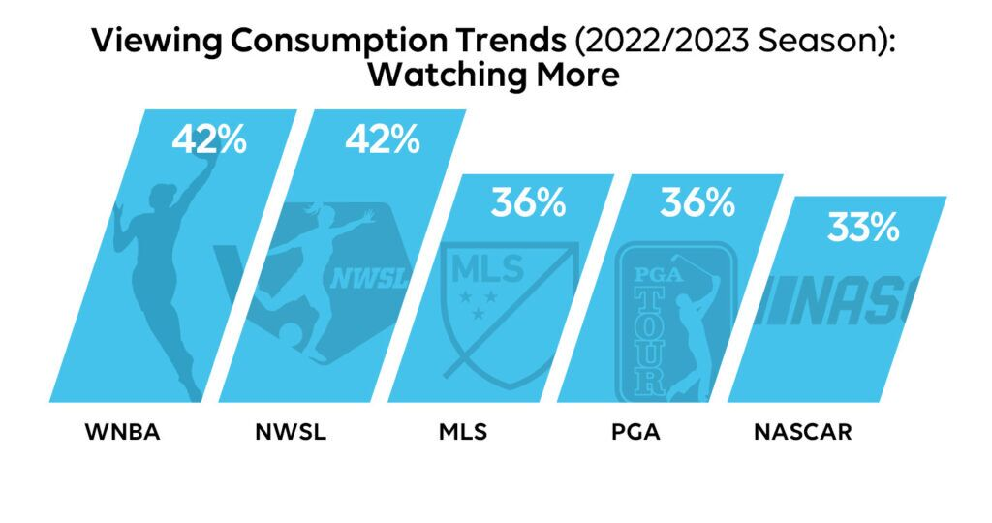
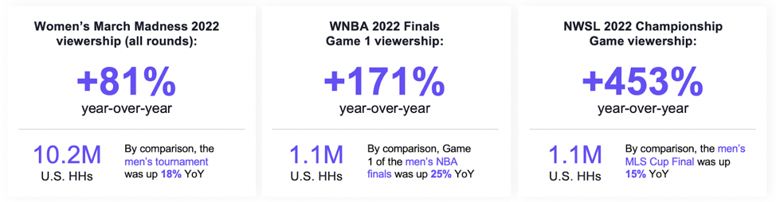
Measuring Activation Success
Key metrics: Sales data, engagement metrics, brand awareness
Tracking social media mentions, website traffic, online interactions
Surveys analysis to assess brand image shifts
Annual tracking to understand consumer benefits within the first year
Continuous evaluation of metrics to ensure long-term success
Notes:
Sales Data: Sales of merchandise and apparel that bear images of the sponsors.
Engagement Metrics: It would involve tracking the number of social media mentions and posts, website traffic, and interaction with online advertising and promotions.
Brand Awareness: The study of the general attitude and opinions of the consumers towards a given product through survey and test groups.

